Slide 1
Crafting Real-Time Mobile Apps with Xamarin & SignalR
Maddy Leger
Program Manager, Xamarin Tooling
@maddyleger1

Slide 2



Real-time Apps
Notes:
Anything from chatting, to dashboards, to quiz and game apps, polling, and more

Slide 3







.NET: Your platform for building anything
Desktop
Web
Cloud
Mobile
Gaming
IoT
AI
.NET
Notes:
As developers we need to be able to reach every platform on the planet. And that is the goal of .NET enabling developers to build for these devices with unique frameworks optimized for each.
Today, we will look at what the Xamarin platform and framework, which are part of .NET offer.

Slide 4
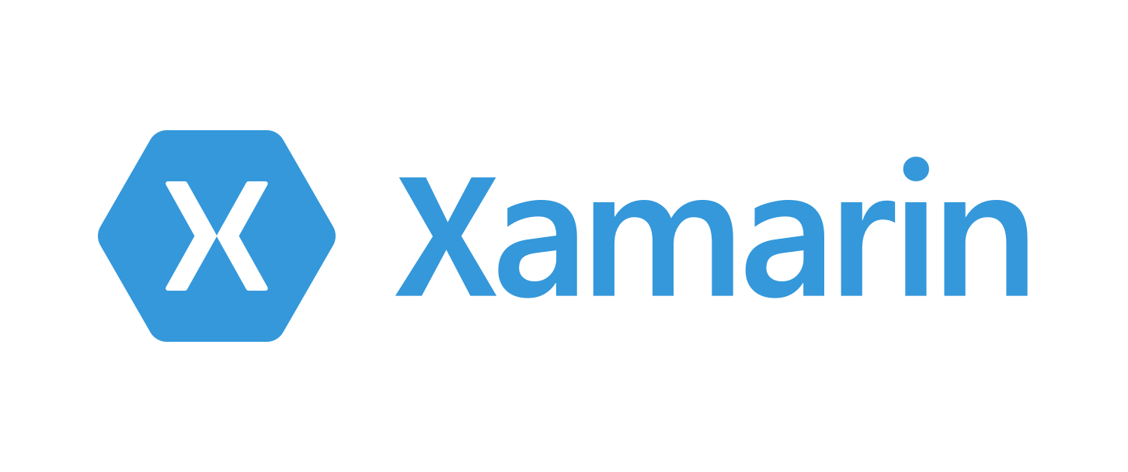

Slide 5
An open source app platform
from Microsoft for
building modern & performant
iOS, Android, macOS,
watchOS, & tvOS apps with .NET.

Slide 6
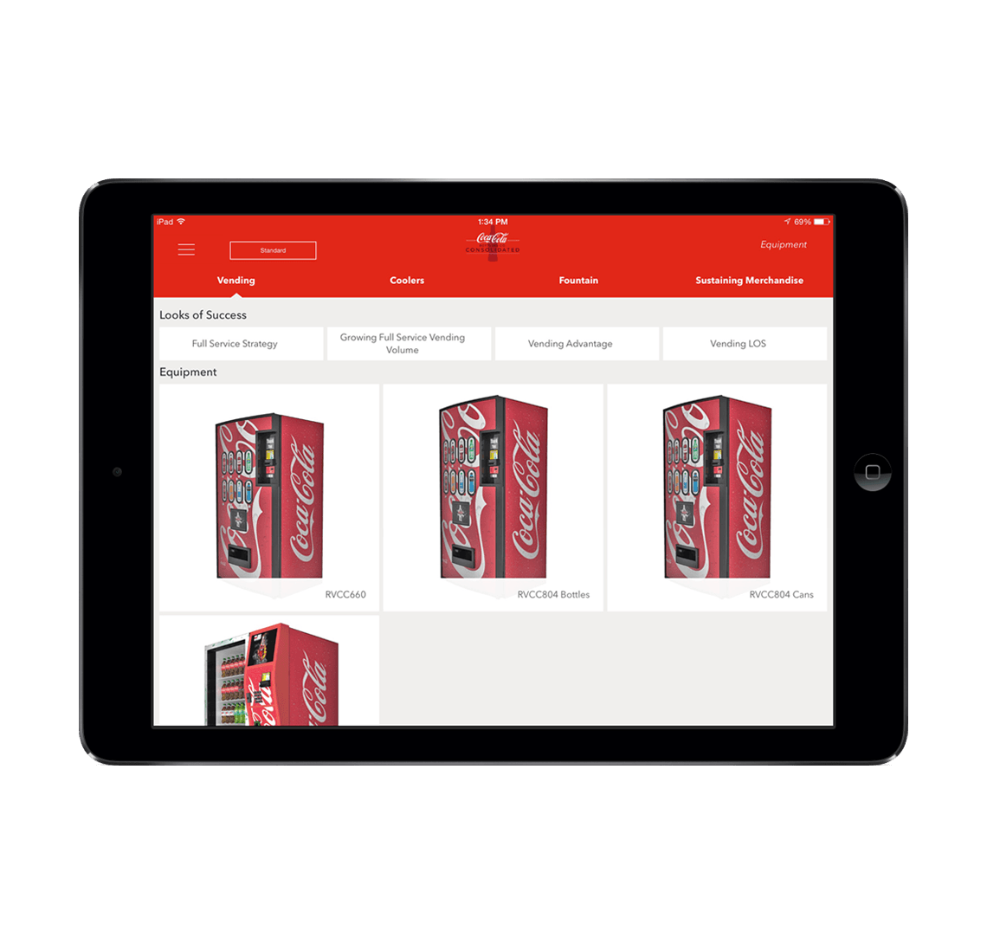




Xamarin App Architecture
.NET
C#
C#
C#
Shared C#
Business Logic • Platform APIs • User Interface
Notes:
First is the core architecture which enables huge amount of code sharing across apps. You can build stunning applications with high fidelity. Let’s talk about what is in each of these blocks, first with the head projects, platform APIs, and user interface. The business logic is just .NET code that can always be shared with other .NET platforms.

Slide 7




























Xamarin
Loved by developers, trusted by enterprise
Notes:
In fact there are tons of companies that entrust Xamarin and .NET today.
These companies leverage Xamarin and .NET across all verticals and all different types of platforms.

Slide 8
App Development With Xamarin
Notes:
So, let’s get into how we build apps with Xamarin.

Slide 9




Productive environment
Maximize code reuse
Native performance & integrations
Expansive ecosystem
Notes:
Xamarin has a goal of delivering on these for core principals. Each of them are exactly what developers need to be super productive. Let’s walk through how Xamarin does this.

Slide 10
Xamarin App Architecture
.NET
C#
C#
C#
Shared C#
Business Logic • Platform APIs • User Interface
Shared C# codebase • 100% native API access • High performance
Notes:
First, it is with it’s unique application architecture. In fact it is the .NET architecture itself. You decided what platforms you want your apps to run on, we call them head projects.
You can access all of the native APIs for each and share a bulk of the C# logic. Here we see business logic, platform APIs, and user interfaces. This can scale to a lot or a little based on what you are trying to achieve. So how exactly does this work?

Slide 11












Native API Access
Notes:
The first part in the head projects is access to any of the unique APIs in iOS and Android. You have access to them all in C#. Now, these do have to be written in the head project and aren’t shared since they are unique to each platform. However, the Xamarin team has a way to help us out there.

Slide 12
Xamarin.Essentials: Cross-Platform Native APIs
.NET
C#
C#
C#
Xamarin.Essentials
Shared C#
Business Logic • User Interface
Notes:
So now, if we look a bit further, this is what our app architecture looks like.

Slide 13

Xamarin.Forms
Notes:
What about the user interface? Just like APIs you can build the native UI for each platform. However, many developers choose to share all or most of the UI with Xamarin.Forms

Slide 14
Xamarin.Forms: Cross-Platform Native UI
.NET
C#
C#
C#
Xamarin.Forms - UI
Xamarin.Essentials
Shared C#
Business Logic
Notes:
We will look more at Xamarin.Forms, but now we can see a full picture of what goes into our app.

Slide 15
Code Sharing
On average Xamarin developers share
80% of code
across mobile apps.
Notes:
Regardless of app approaches and if you need to mix in native APIs or UI in addition to Xamarin.Essentials and Xamarin.Forms, the average app shares nearly 80% of code.

Slide 16
Native performance
ARM BINARY
IL + JIT
.NET
.NET
.NET
AOT
.APP
Compile and Link
.APK
C#
C#
C#
Runs natively
Runs natively
Bindings
Bindings
Bindings
Xamarin.iOS does full Ahead Of Time (AOT) compilation to produce an ARM binary for Apple’s App Store.
Xamarin.Android takes advantage of Just In Time (JIT) compilation on the Android device.
Notes:
In addition, Xamarin apps fully compile down into native binaries for each platform.

Slide 17

Notes:
Naturally Xamarin and .NET apps work absolutely amazing for cloud apps with Microsoft Azure.

Slide 18

Notes:
An ASP.NET library used to deliver real-time web functionality to applications – like code push to all connected clients. It uses the concept of RPC (remote procedure calls) to function at the ASP.NET level. NOT request/response!

Slide 19




SignalR
HUB

Slide 20
Send Message
SignalR
HUB

Slide 21

Features
Handles connection management automatically
Sends messages to all connected clients simultaneously
Sends messages to specific clients or groups of clients
Scales to handle increasing traffic
Can be hosted locally or on Azure SignalR Service
Transports
WebSockets
Server-Sent Events
Long Polling

Slide 22
SignalR Azure Service
Based on SignalR ASP.NET Core Library
Fully native ASP.NET Core support
Designed for large-scale and multi instances
Off-prem, multi server hosting
Runs on Linux, Mac, and Windows
Works with apps hosted in Azure App Service, IIS, Nginx, Docker
Azure handles performance, scalability, and availability, plus websocket load balancing

Slide 23
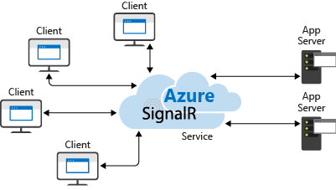
SignalR at Scale

Slide 24
SignalR SDK Availability
Server (Hub)
.NET
Azure SignalR Service
Client
.NET (ASP.NET, Xamarin, Windows, etc.) - .NET Standard
JavaScript/TypeScript
Java

Slide 25
Send to Others
Send Message
SignalR
HUB

Slide 26
Send to Group
Send Message
SignalR
HUB

Slide 27
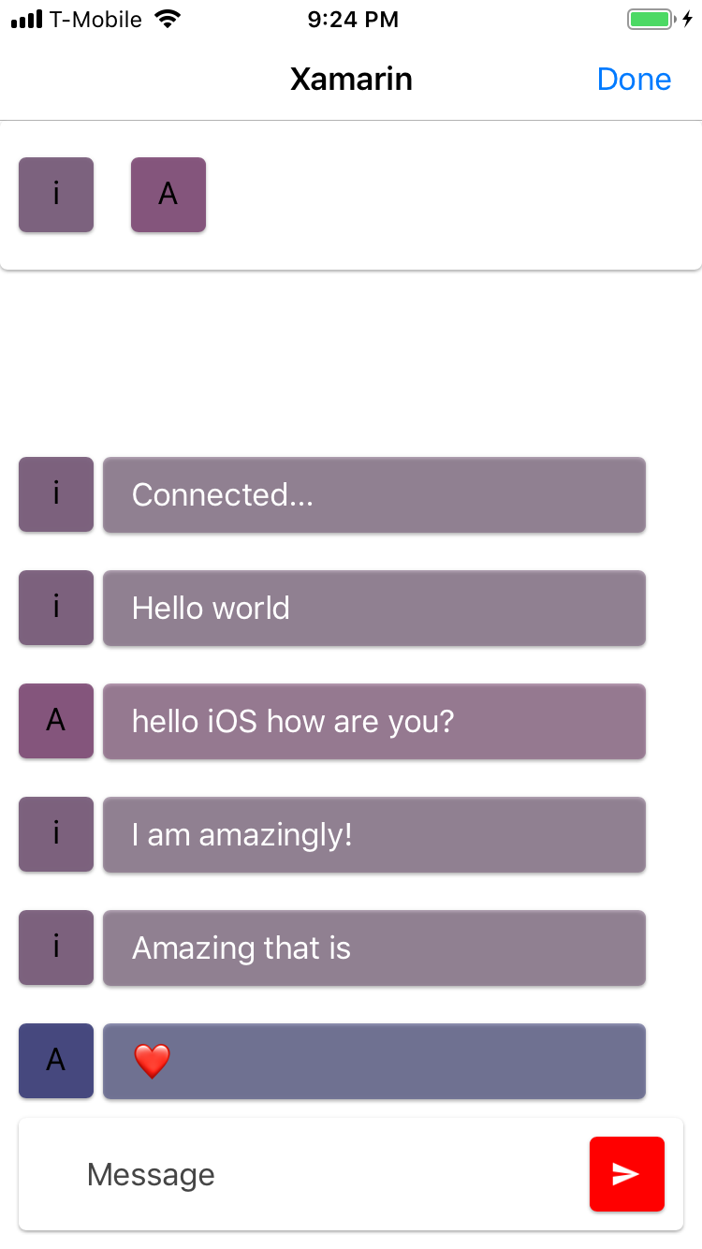
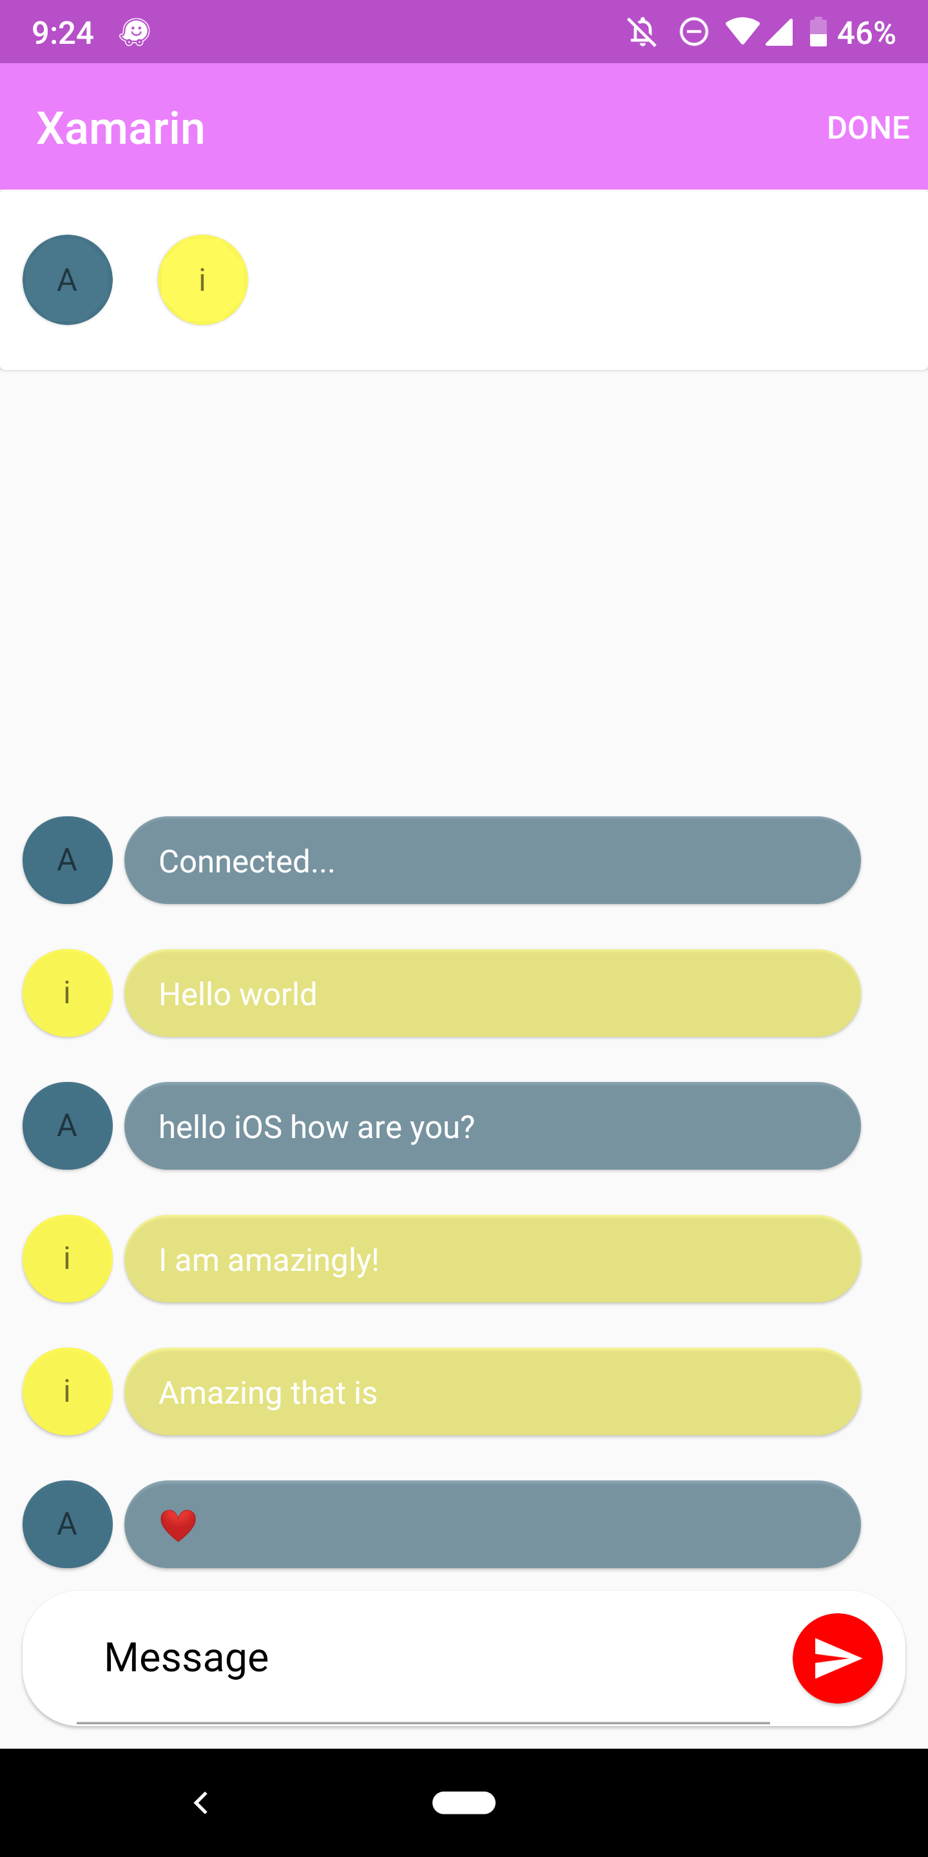
XamChat!
Demo

Slide 28
Basic Local SignalR Chat App

Slide 29
Local SignalR Hub using Azure SignalR Service

Slide 30
Put it all on the cloud!

Slide 31
Who needs servers, anyways?

Slide 32
Thank you
aka.ms/xamarin
github.com/maddyleger1/AzureXamChat
Maddy Leger
Program Manager | Xamarin Tooling
Microsoft
maddy@microsoft.com
@maddyleger1

